Slide 1
POWER BI PROJECT REPORT: FINANCE DATASET ANALYSIS
NAME:
AJITHA J

Slide 2
OBJECTIVE
Develop a Power BI Solution: Create an efficient analysis system for a financial dataset.
Leverage a Star Schema Model: Design and implement a star schema to optimize data organization.
Data Preparation and Transformation: Import, clean, and transform data for seamless analysis.
Implement DAX Measures: Use DAX expressions to generate insights into sales, profit margins, and financial trends.

Slide 3
DEVELOPMENT PROCESS OF POWER BI FINANCIAL DATASET ANALYSIS
Data Preparation:
Cleaned and shaped raw data using Power Query.
Addressed missing values, standardized column names, and ensured accurate data types.
Data Modeling:
Designed a star schema with a fact table and dimension tables for regions, products, and dates.
Established relationships for efficient aggregation and filtering.
Advanced Calculations with DAX:
Developed custom measures for metrics like gross sales, net sales, and profit.
Implemented dynamic calculations, including year-over-year growth and profit segmentation.
Interactive Dashboard Design:
Built a Power BI dashboard with visuals like charts, KPIs, and slicers.
Enabled dynamic filtering for tailored data exploration.

Slide 4
METHODOLOGY
Data Import: Imported the financial dataset (Excel format) into Power BI Desktop and verified schema consistency.
Column Management: Removed unnecessary fields to streamline the dataset.
Handling Missing Data: Replaced or removed null values to ensure data quality.
Data Type Corrections: Formatted numeric fields as currency and date fields appropriately.
Column Renaming: Simplified column names for better clarity (e.g., "Mfr_Price" to "Manufacturing Price").
Data Modeling: Implemented a star schema with a fact table (transactions) and dimension tables (regions, products, dates).
Relationships: Established primary and foreign key relationships to enable accurate data aggregation and filtering.

Slide 5
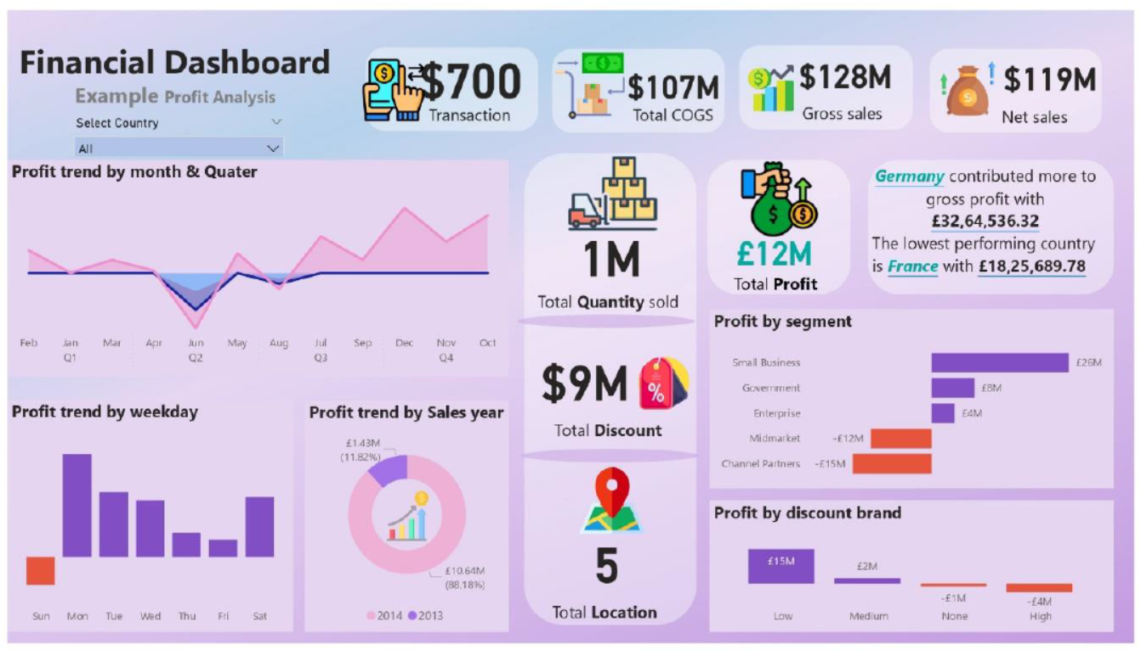

Slide 6
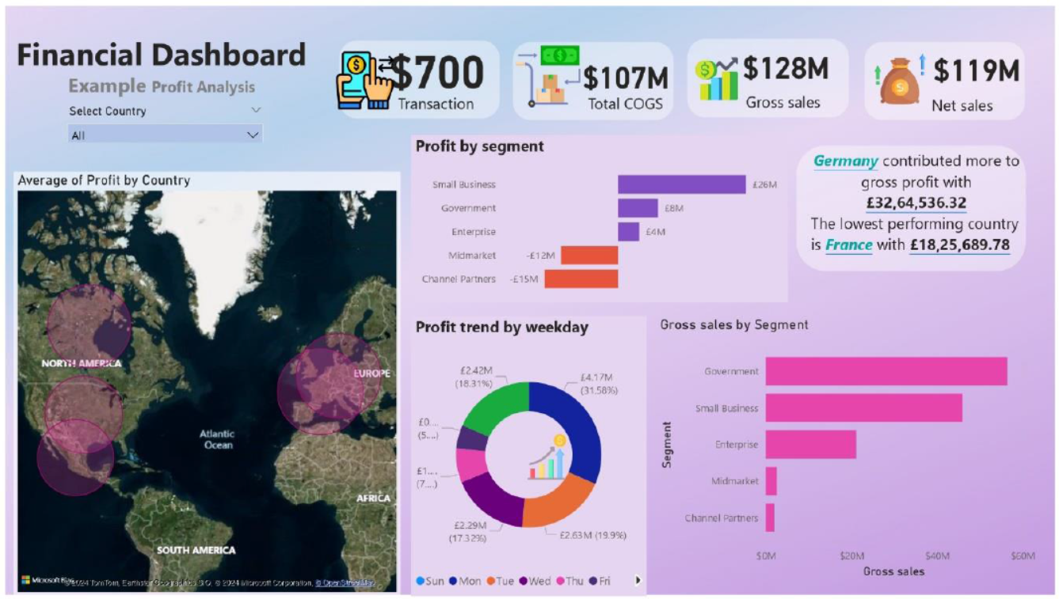

Slide 7
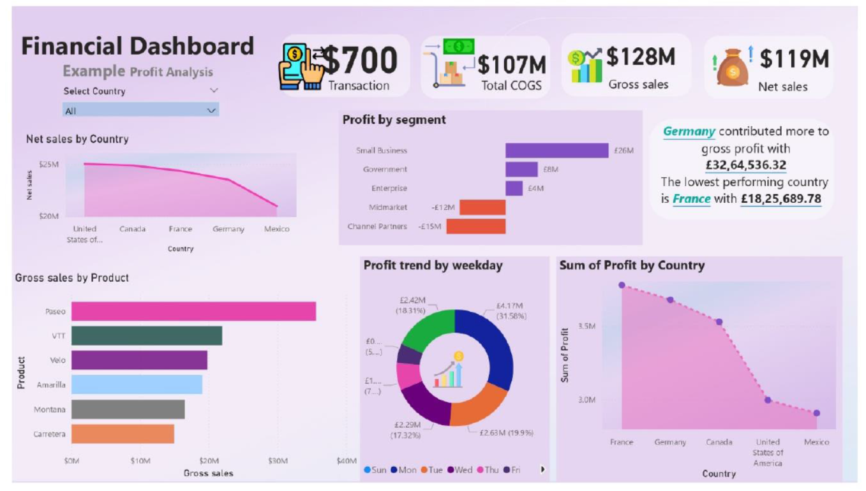

Slide 8
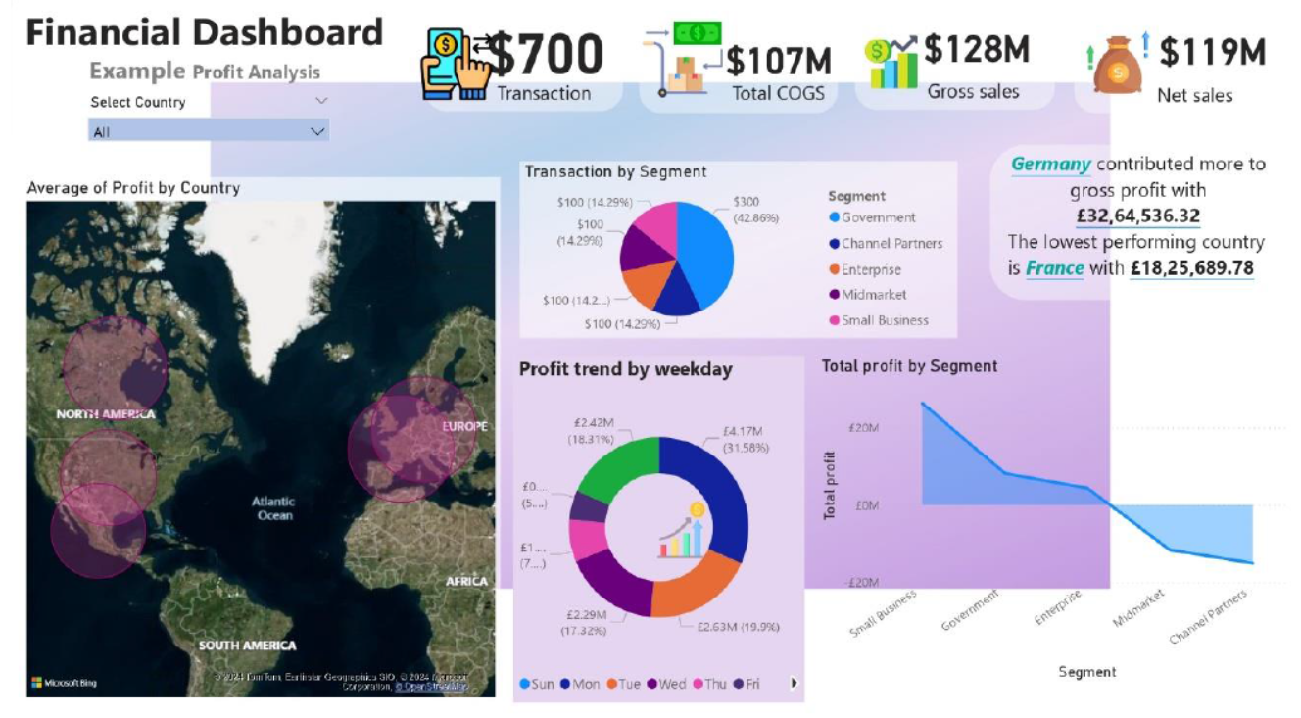

Slide 9
RESULTS
Sales Trends: Identified monthly and yearly sales growth patterns.
Regional Performance: Highlighted top-performing regions and underperforming markets.
Profit Drivers: Pinpointed key products and customer segments driving profitability.
Discount Impact: Analyzed the effect of discounts on revenue and profit margins.

Slide 10


